Slide 1
Machine Learning Algorithms (III-IV)
Master´s in Applied Artificial Intelligence
Luís Ferreira
lufer@ipca.pt

Slide 2
Overview
Part I
Artificial Intelligence and Machine Learning
Foundations
Part II
Machine Learning
Part III
Machine Learning Algorithms
Parte IV
Deep Learning & Neural Networks
Parte V
Building a ML Model

Slide 3
Part III
Machine Learning Algorithms
Competencies to be acquired:
Feature manipulation (cont.)
Feature Scaling

Slide 4
Part III: MLA
Modelling (Review)
Features Selection:
  Filter Methods
  Wrapper Methods
  Embedded Methods

Slide 5
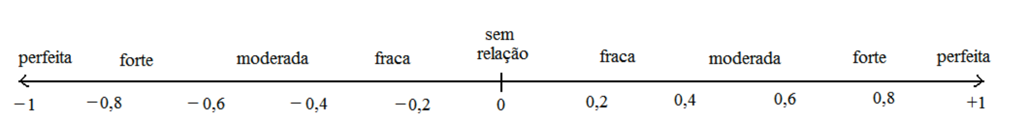
Part III: MLA
Modelling (Review)
Correlation

Slide 6
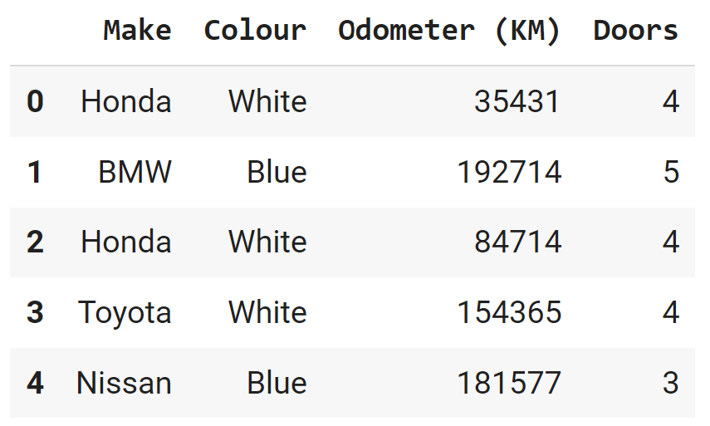
Part III - MLA
Modelling
Features Manipulation: Categorical to Numerical
  Turn categories into numbers
  Datasets must have numerical values to be
  used by any model.
  Example: only numerical values can be
  correlated!
See other example: https://www.geeksforgeeks.org/how-to-convert-categorical-variable-to-numeric-in-pandas/
Notes:
https://www.geeksforgeeks.org/how-to-convert-categorical-variable-to-numeric-in-pandas/

Slide 7
Part III - MLA
Modelling
Features Manipulation: Categorical to Numerical
  Turn categories into numbers, using:
    replace() method
    get_dummies() method
    OneHotEncoder
Notes:
https://www.geeksforgeeks.org/how-to-convert-categorical-variable-to-numeric-in-pandas/

Slide 8
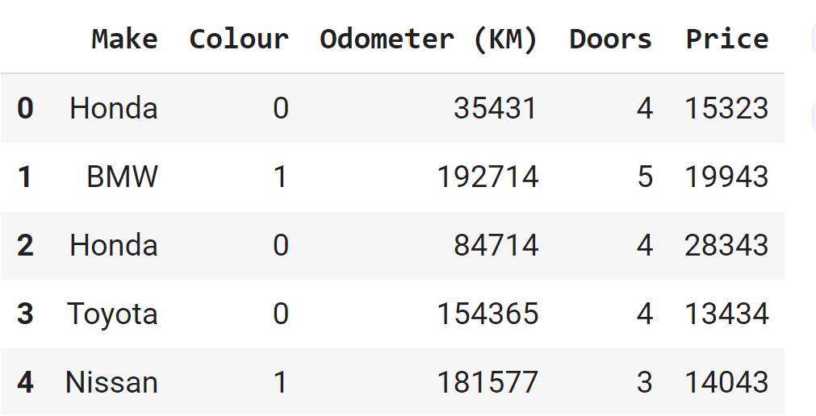
Part III - MLA
Modelling
Features Manipulation: Categorical to Numerical
  replace() method
# replacing values
ds[‘Colour'].replace([‘White’, ‘Blue‘], [0, 1], inplace=True)
Notes:
https://www.geeksforgeeks.org/how-to-convert-categorical-variable-to-numeric-in-pandas/

Slide 9
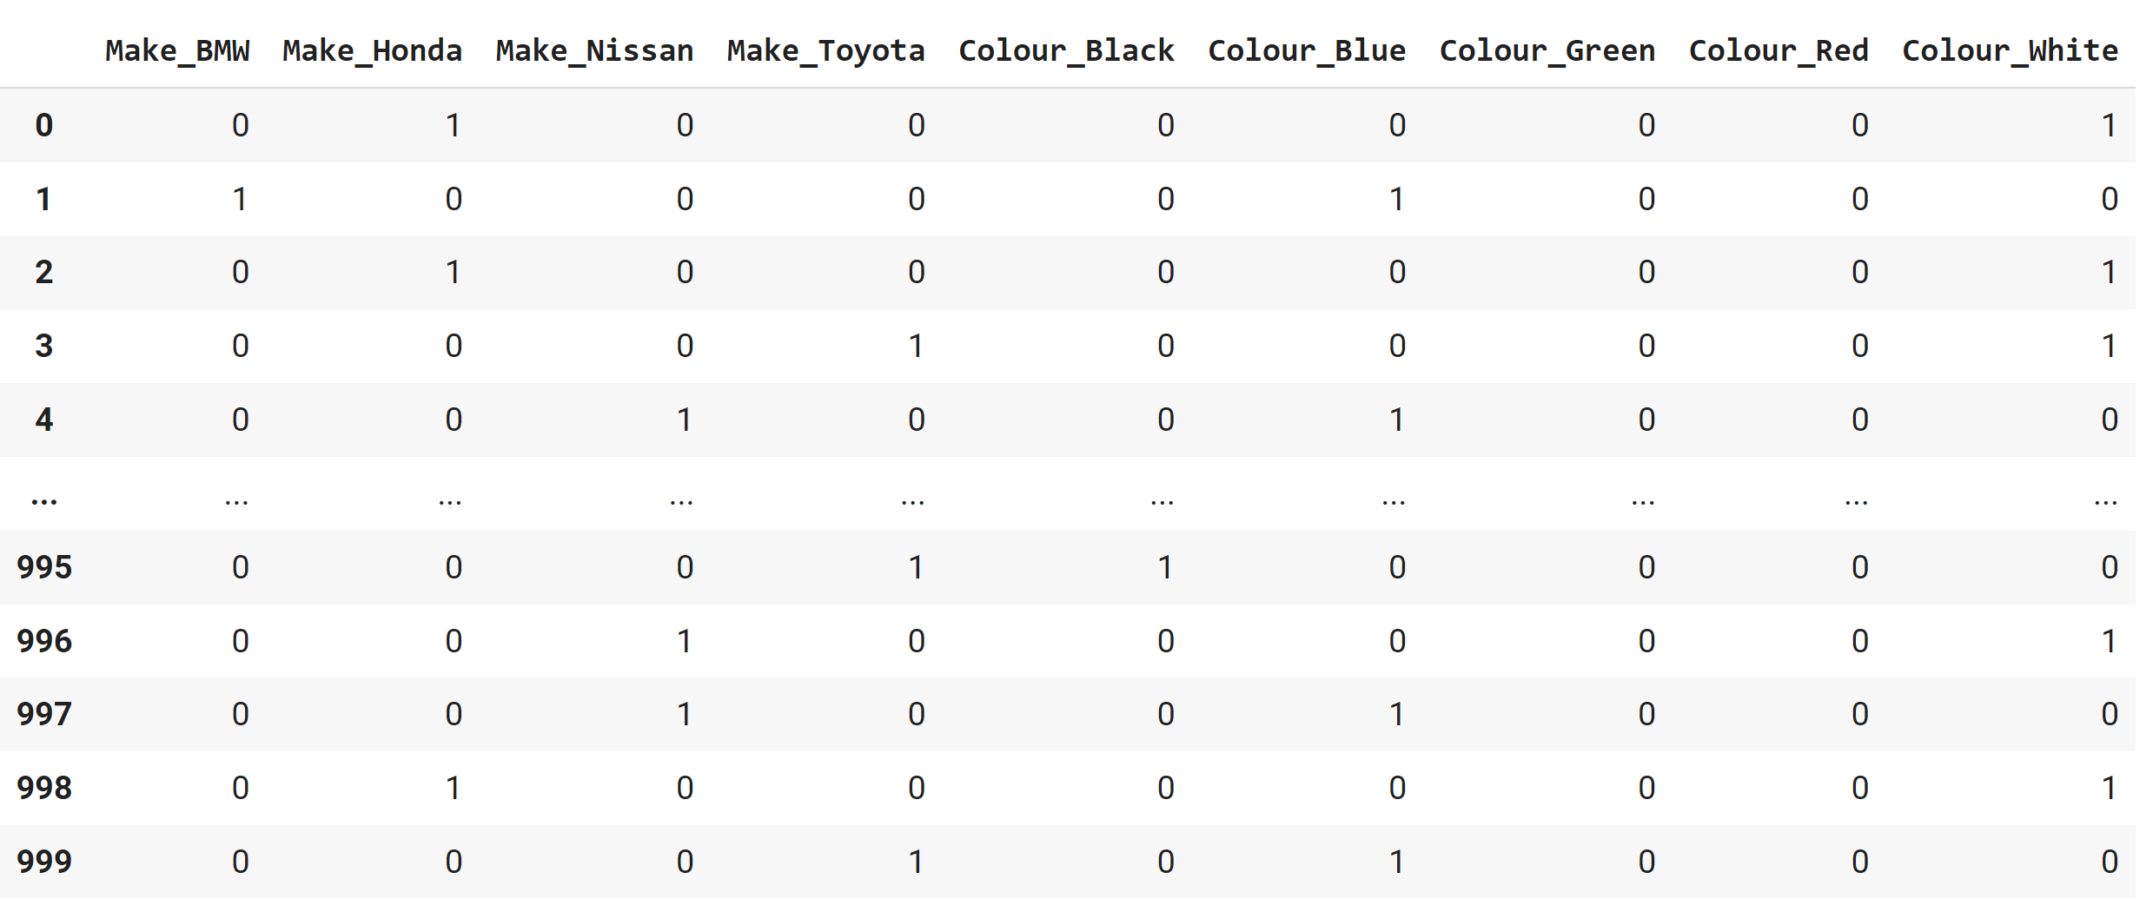
Part III - MLA
Modelling
Features Manipulation: Categorical to Numerical
  get_dummies() method
    Create dummy
    columns
    Concatenate datasets
    Drop original columns
dummies = pd.get_dummies(ds[["Make","Colour"]])
dummies dataset
Notes:
https://www.geeksforgeeks.org/how-to-convert-categorical-variable-to-numeric-in-pandas/

Slide 10
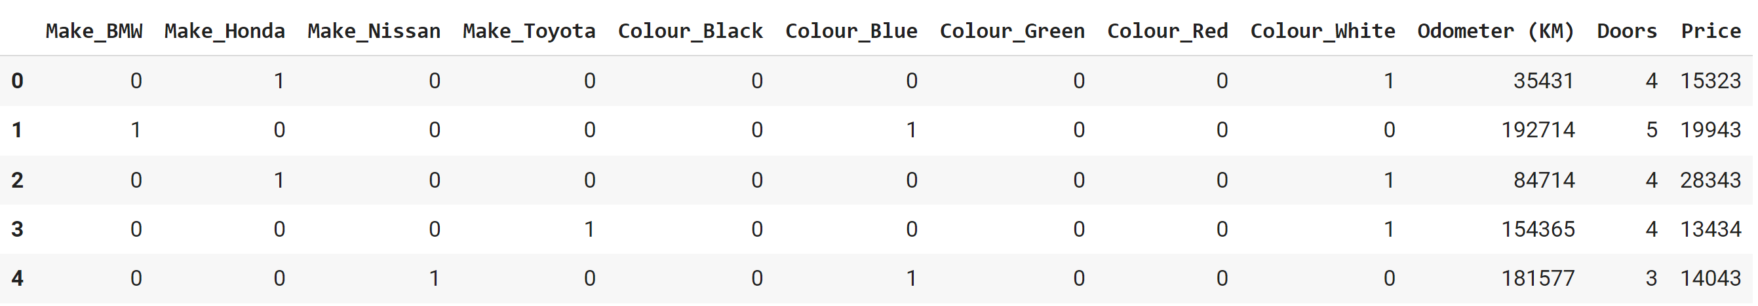
Part III - MLA
Modelling
Features Manipulation: Categorical to Numerical
  get_dummies() method
    Create dummy
    columns
    Concatenate datasets
    Drop original columns
dummies = pd.get_dummies(ds[["Make","Colour"]])
Final numerical dataset
Notes:
https://www.geeksforgeeks.org/how-to-convert-categorical-variable-to-numeric-in-pandas/

Slide 11
Part III - MLA
Modelling
Features Manipulation: Categorical to Numerical
  OneHotEncoder
Notes:
https://www.geeksforgeeks.org/how-to-convert-categorical-variable-to-numeric-in-pandas/

Slide 12
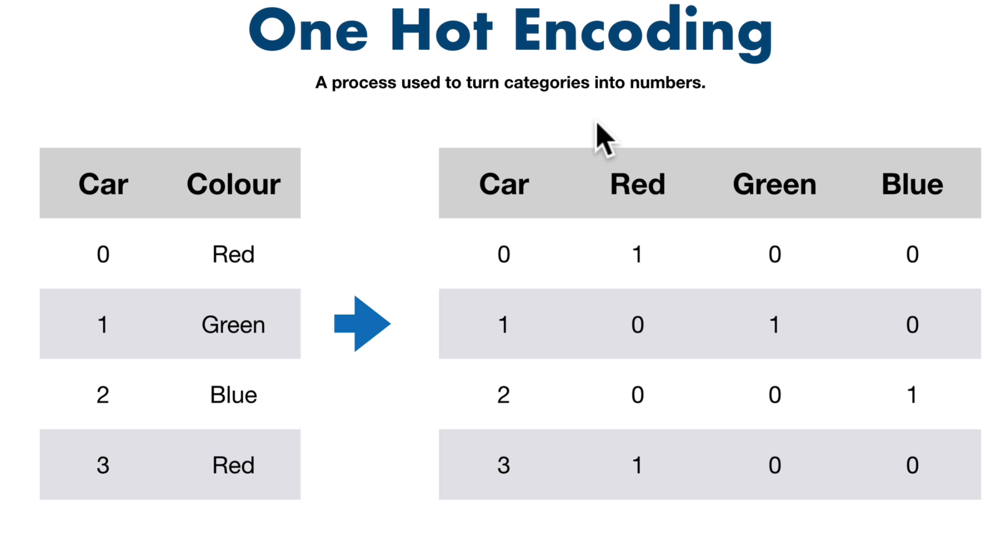
Part III - MLA
Modelling
Features Manipulation: Categorical to Numerical
  OneHotEncoder
Notes:
https://www.geeksforgeeks.org/how-to-convert-categorical-variable-to-numeric-in-pandas/

Slide 13
Part III - MLA
Modelling
Features Manipulation: Categorical to Numerical
  OneHotEncoder
# Assigning numerical values and storing it in another columns
cs['Make_new'] = cs['Make'].cat.codes
cs['Colour_new'] = cs['Colour'].cat.codes
# Create an instance of One-hot-encoder
one_hot = OneHotEncoder()
enc_data = pd.DataFrame(one_hot.fit_transform(cs[['Make_new', 'Colour_new']]).toarray())
Notes:
https://www.geeksforgeeks.org/how-to-convert-categorical-variable-to-numeric-in-pandas/

Slide 14
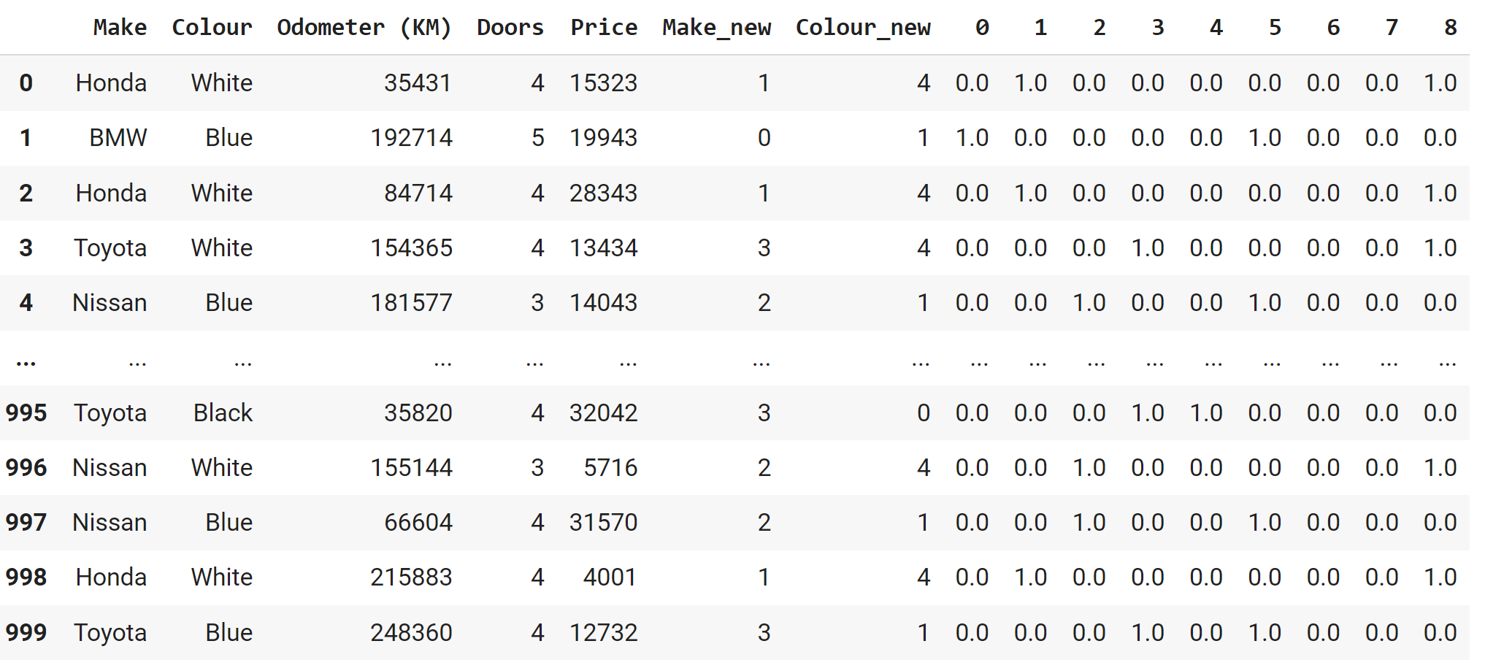
Part III - MLA
Modelling
Features Manipulation: Categorical to Numerical
  OneHotEncoder
# Assigning numerical values and storing it in another columns
cs['Make_new'] = cs['Make'].cat.codes
cs['Colour_new'] = cs['Colour'].cat.codes
# Create an instance of One-hot-encoder
one_hot = OneHotEncoder()
enc_data = pd.DataFrame(one_hot.fit_transform(cs[['Make_new', 'Colour_new']]).toarray())
Notes:
https://www.geeksforgeeks.org/how-to-convert-categorical-variable-to-numeric-in-pandas/

Slide 15
Part III: MLA
Modelling (Review)
Feature Scaling
  Dealing with datasets containing features that have different ranges, units of measurement, or orders of magnitude.
  Dataset’s features can be transformed to a more consistent scale, making it easier to build accurate and effective machine learning models.

Slide 16
Part III: MLA
Modelling (Review)
Feature Scaling
  Standardization
  Normalization | Min-max scaling

Slide 17

Part III: MLA
Modelling (Review)
Feature Scaling: Standardization
  Values are centred around the mean with a unit standard deviation
  is the mean of the feature values
  is the standard deviation of the feature values
  Applied standardization to my numerical columns, not the other One-Hot Encoded (they are already between 0 and 1)!

Slide 18
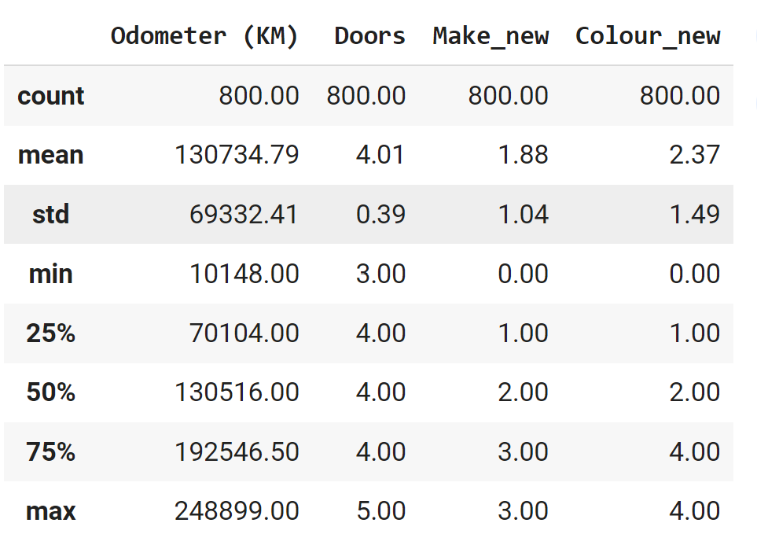
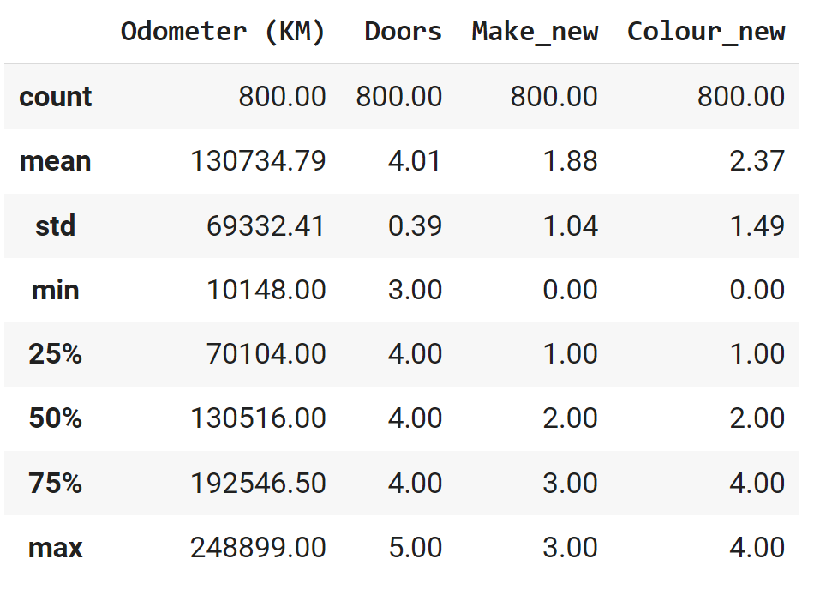
Part III: MLA
Modelling (Review)
Feature Scaling: Standardization
  Values are centred around the mean with a unit standard deviation
  is the mean of the feature values
  is the standard deviation of the feature values
  Applied standardization to my numerical columns, not the other One-Hot Encoded (they are already between 0 and 1)!

Slide 19

Part III: MLA
Modelling (Review)
Feature Scaling: Normalization
  Is a data preprocessing technique employed to standardize the values of features in a dataset, bringing them to a common scale.
  This process enhances data analysis and modelling accuracy by mitigating the influence of varying scales on machine learning models.
  Values are shifted and rescaled so that they end up ranging between 0 and 1

Slide 20
Part III: MLA
Modelling (Review)
Feature Scaling: Normalization
  Is a data preprocessing technique employed to standardize the values of features in a dataset, bringing them to a common scale.
  This process enhances data analysis and modelling accuracy by mitigating the influence of varying scales on machine learning models.
  Values are shifted and rescaled so that they end up ranging between 0 and 1
# first remove non numerical columns
from sklearn.preprocessing import MinMaxScaler
# fit scaler on training data
norm = MinMaxScaler().fit(X_train)
# transform training data
X_train_norm = norm.transform(X_train)
# transform testing dataabs
X_test_norm = norm.transform(X_test)

Slide 21
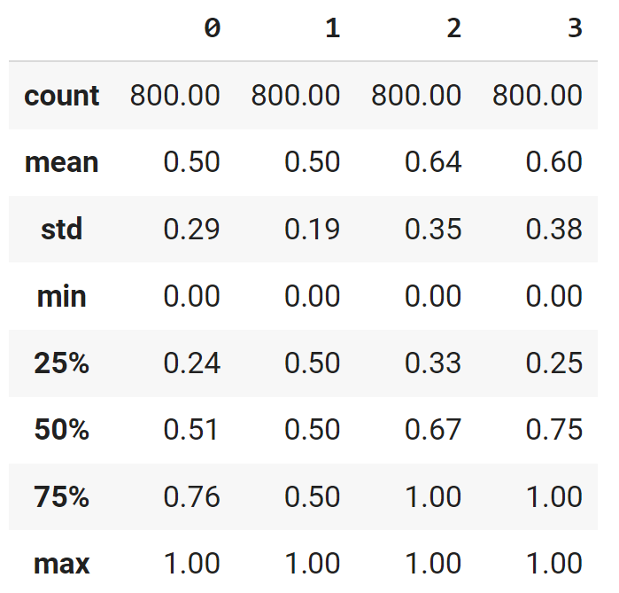
Part III: MLA
Modelling (Review)
Feature Scaling: Normalization
  Is a data preprocessing technique employed to standardize the values of features in a dataset, bringing them to a common scale.
  This process enhances data analysis and modelling accuracy by mitigating the influence of varying scales on machine learning models.
  Values are shifted and rescaled so that they end up ranging between 0 and 1

Slide 22
Part III - MLA
Explore
Feature Scaling: Practice review
  Jupyter Notebook
  4_Data_Manipulation_Modelling_III.ipynb
Notes:
https://statplace.com.br/blog/coeficientes-de-correlacao/

Slide 23
Progress
Part I
Artificial Intelligence and Machine Learning
Foundations
Part II
Machine Learning
Part III
Machine Learning Algorithms (I)
Part IV
Machine Learning Algorithms (I)
Part V
Deep Learning & Neural Networks

Slide 24
References
Feature Scaling - why is it required? by Rahul Saini
Feature Scaling with Scikit-Learn by Ben Alex Keen
Feature Scaling for Machine Learning: Understanding the Difference Between Normalization vs. Standardization by Aniruddha Bhandari
Feature Scaling: Engineering, Normalization, and Standardization
  https://www.analyticsvidhya.com/blog/2020/04/feature-scaling-machine-learning-normalization-standardization/

Slide 25
References
The Lifecycle of an AI
  https://labelyourdata.com/articles/lifecycle-of-an-ai-project-stages-breakdown#step_4_scrub_your_data_clean
Examples of Machine Learning Projects
  https://www.datacamp.com/blog/machine-learning-projects-for-all-levels
Elements of AI (free online course)
  https://www.elementsofai.com/

Slide 26
References
Google Colab
  https://colab.research.google.com/
Pandas Tutorial
  https://www.w3schools.com/python/pandas/ref_df_sample.asp

Slide 27
References
Machine Learning. Tom M. Mitchel, McGraw-Hill, 1997
Machine Learning for Everyone
  https://vas3k.com/blog/machine_learning/
Machine Learning Tutorial
  https://www.simplilearn.com/tutorials/machine-learning-tutorial/machine-learning-steps
What is machine learning and how does it work? In-depth guide
  https://www.techtarget.com/searchenterpriseai/definition/machine-learning-ML

Slide 28
Appendices

Slide 29
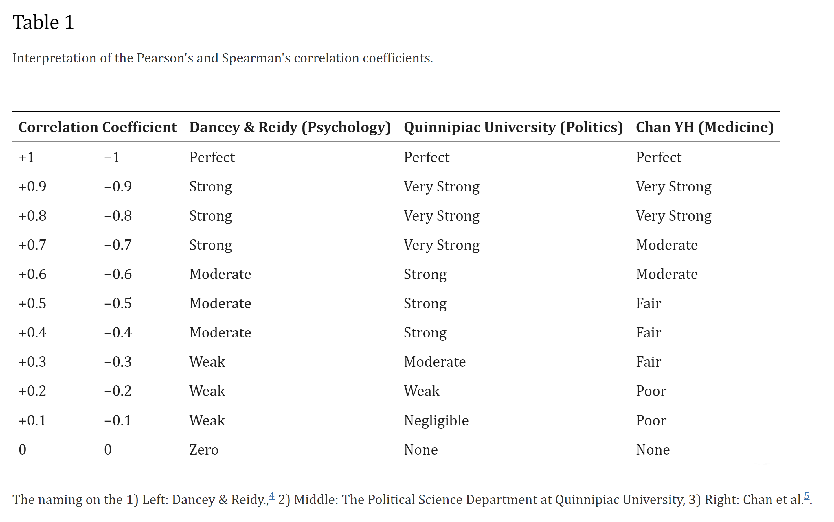
Notes:
https://vas3k.com/blog/machine_learning/

Slide 30
Normalization | Standardization
Rescales values to a range between 0 and 1 | Centers data around the mean and scales to a standard deviation of 1
Useful when the distribution of the data is unknown or not Gaussian | Useful when the distribution of the data is Gaussian or unknown
Sensitive to outliers | Less sensitive to outliers
Retains the shape of the original distribution | Changes the shape of the original distribution
May not preserve the relationships between the data points | Preserves the relationships between the data points
Equation: (x – min)/(max – min) | Equation: (x – mean)/standard deviation
https://www.analyticsvidhya.com/blog/2020/04/feature-scaling-machine-learning-normalization-standardization/
Notes:
https://vas3k.com/blog/machine_learning/

